Slide 1
SCIENTIFIC COMPUTING Python Essentials
SEBASTIÁN ROLDÁN VASCO, MSc., PhD.
sebastianroldan@itm.edu.co

Slide 2
What is scientific computing?
It is the application of computer programming techniques to solve scientific problems
Numerical computations:
Complex mathematical calculations and numerical simulations
Exempli gratia (e.g.) differential equations, optimization problems, statistical analysis
Data Analysis and Visualization:
Analysis of large datasets to extract meaningful insights
E.g. violin plots, spatial distributions, radar maps, diffusion cartograms

Slide 3
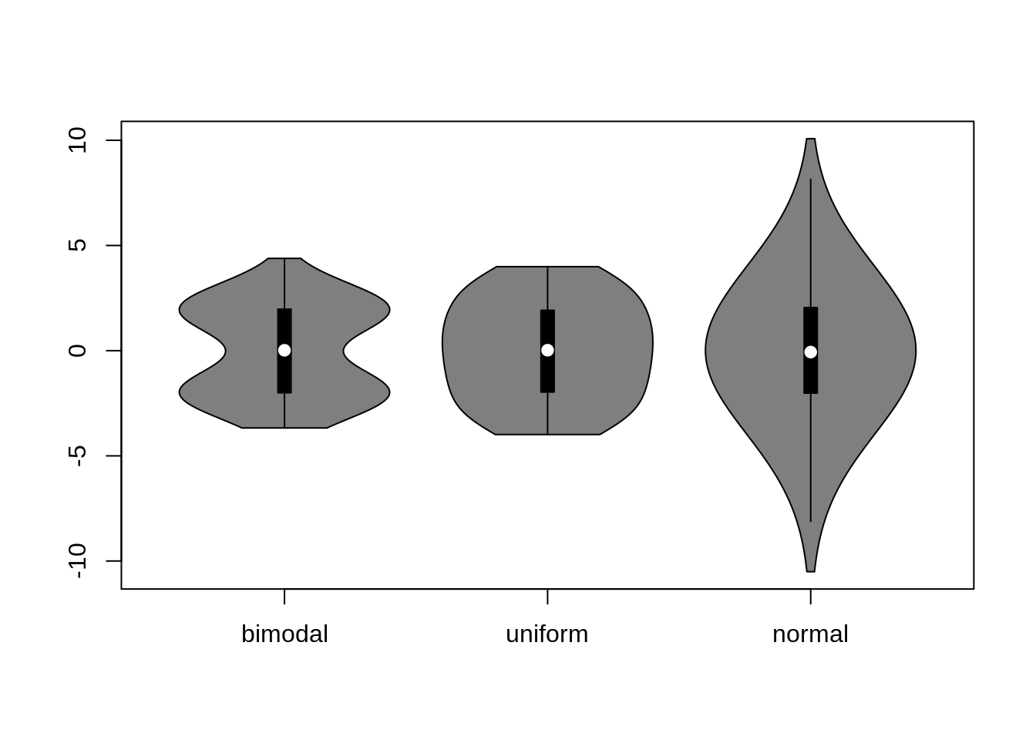
What is scientific computing?
https://jtr13.github.io/cc20/introduction-to-violin-plots.html

Slide 4
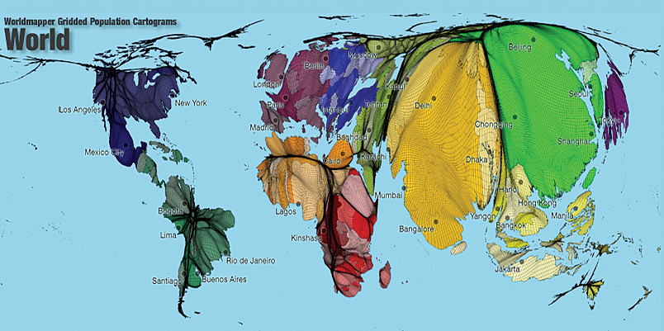
What is scientific computing?
https://www.esri.com/news/arcuser/0110/cartograms.html

Slide 5
What is scientific computing?
Algorithm design:
To handle complex computations and optimize performance
E.g. linear algebra, optimization, signal processing, machine learning
Modeling and Simulation:
From simple mathematical models to complex simulations
E.g. linear regression, Support Vector Machines, Convolutional Neural Networks
Interdisciplinary collaboration:
S.P. involves different disciplines, such as physics, biology, chemistry, engineering, and computer science.

Slide 6
Programming languages for SC
Python
Matlab
R
Julia
Fortran
Javascript
etc
They have tools, libraries and frameworks tailored to SC problems and tasks

Slide 7
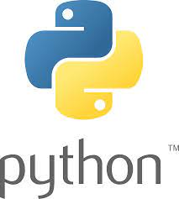
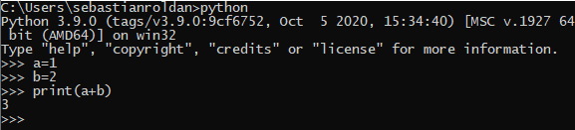
Python
Programming language created in the 1990s (Guido van Rossum)
High-level language, like C, C++, Perl, Java:
Easy to write
Portable
Python is an interpreted language:
Interpreter in command mode
Script mode interpreter (.py files)

Slide 8
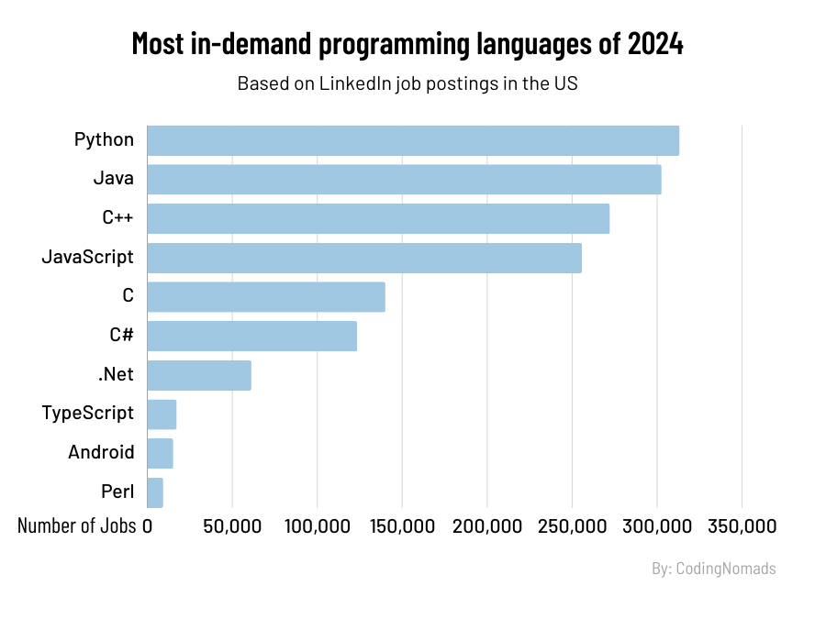
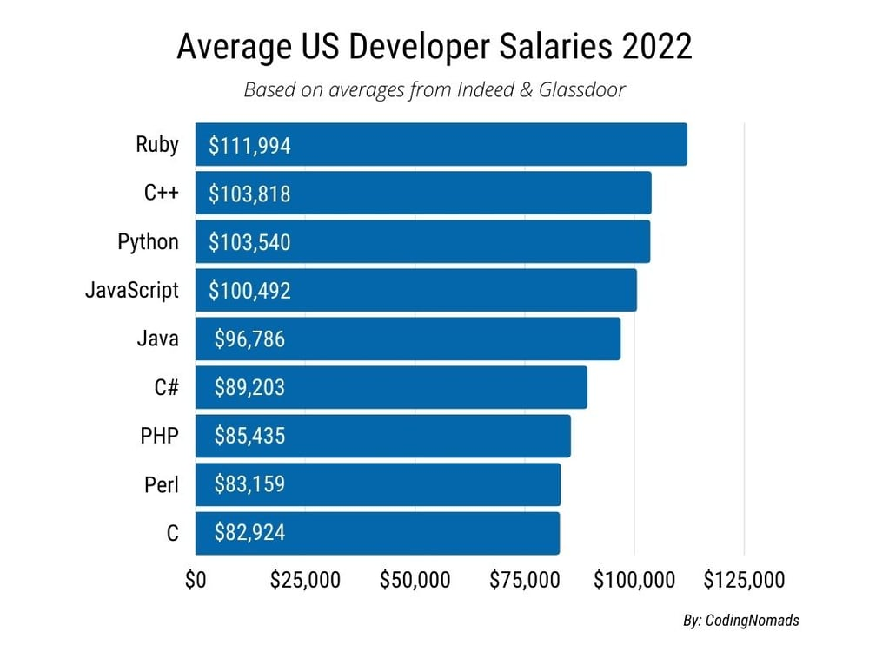
Why Python?
https://codingnomads.co/blog/the-best-programming-languages-to-learn/

Slide 9
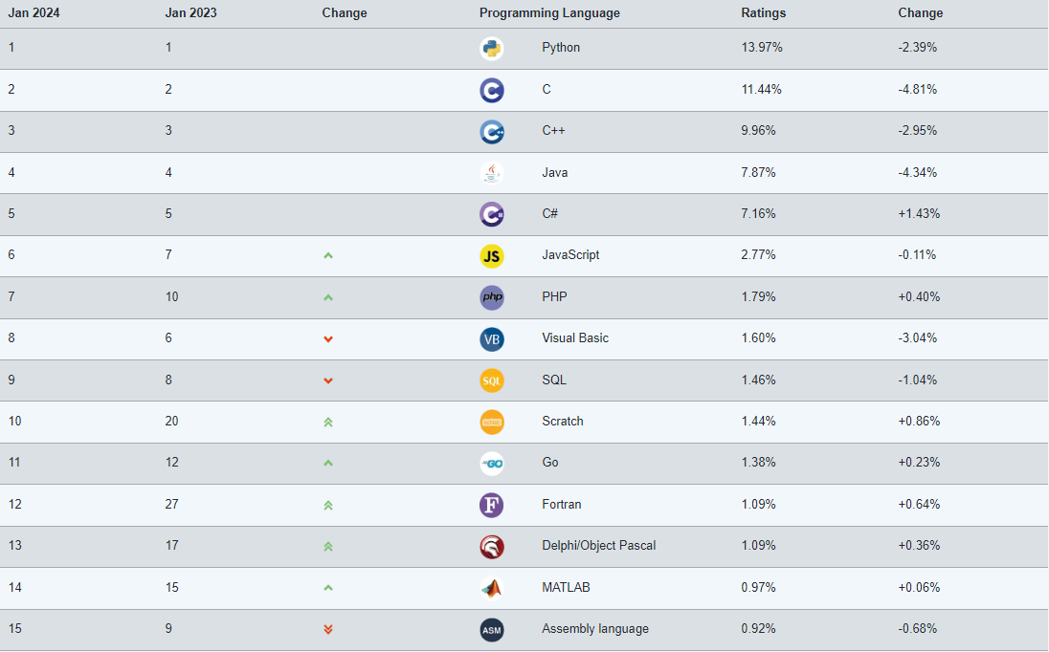
Why Python?
The most popular programming language according to the TIOBE Index - TIOBE

Slide 10
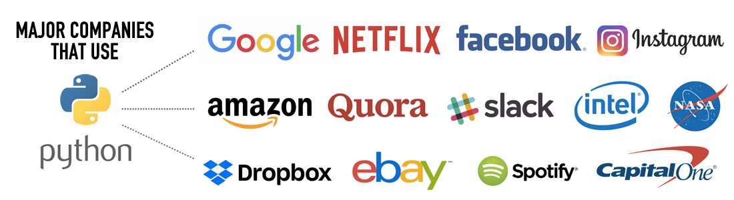
Why Python?
It is an OPEN-SOURCE SOFTWARE
Versatility: data mining, AI, machine learning, Deep learning, web development, embedded systems, etc.
https://codingnomads.co/why-learn-python/

Slide 11
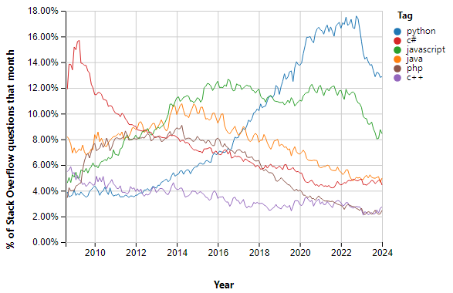
Why Python?
https://insights.stackoverflow.com/trends?tags=python%2Cjava%2Cjavascript%2Cc%23%2Cc%2B%2B%2Cphp

Slide 12
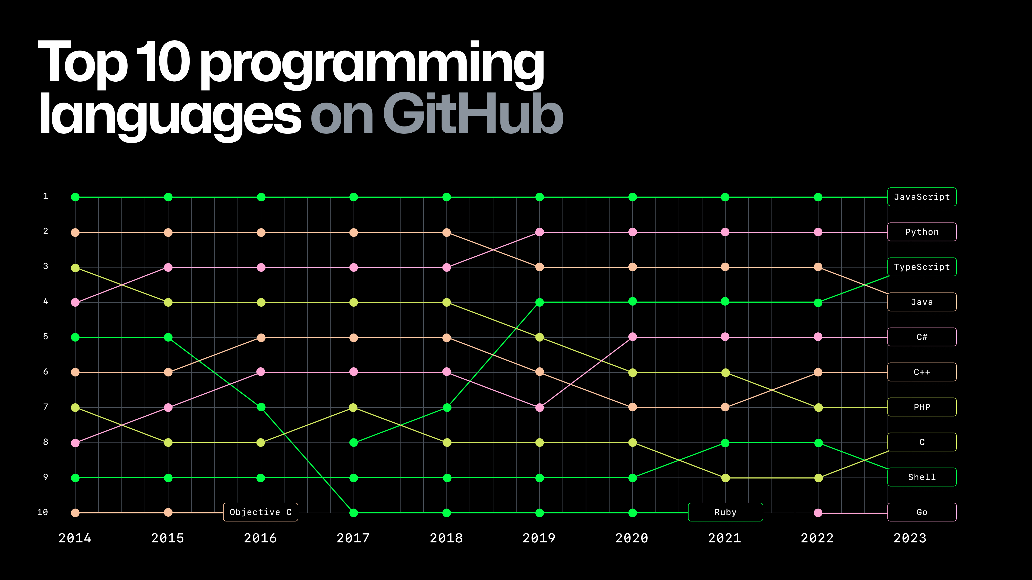
Why Python?
https://github.blog/2023-11-08-the-state-of-open-source-and-ai/

Slide 13
Integrated Development Environment (IDE)
An IDE primarily includes:
Code editor
Code debugger
Local build automation

Slide 14



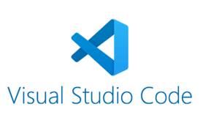

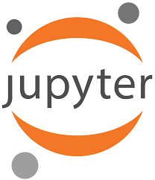


Integrated Development Environment (IDE)
Web-based interactive development environment for notebooks, code, and data
Distribution of the Python and R programming languages for scientific computing

Slide 15
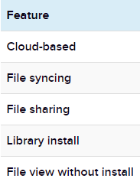
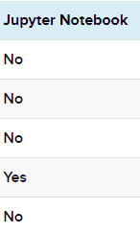
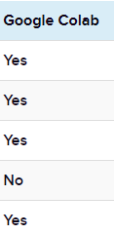
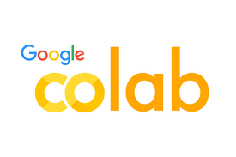
Integrated Development Environment (IDE)
https://www.techrepublic.com/article/google-colab-vs-jupyter-notebook/

Slide 16



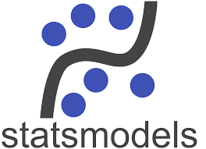

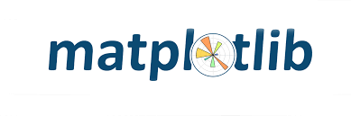
(Essential) Libraries for scientific computing

Slide 17
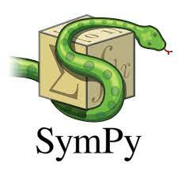


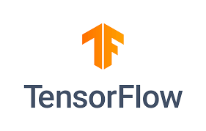
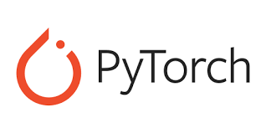
Libraries for scientific computing

Slide 18
Python recall – data collections
Python has three main built-in data collections:
Lists
Ordered collections of items (which could be of different type)
Numerical index
Defined using square brackets [ ]
Allow slicing
Tuples
Similar to lists but immutable → less memory space
Defined using commas (parentheses are not necessary)
Dictionaries
Unordered collections of key-value pairs → No slicing
Defined using curly braces { }
Immutable key, mutable values

Slide 19
Python recall – data collections
But… there are other types of data collections:
Sets
Ordered collections of items
Mutable
Cannot be accessed by index
Does not allow duplicate elements.
Defined using curly braces { }
Strings
Collection of characters
Immutable (cannot be modified)
Accessed by index

Slide 20
Python recall – data collections
Bytes and Byte Arrays
Collection of bytes (integers from 0 to 255)
Immutable (bytes) and mutable (byte arrays)
Strings
Collection of characters
Immutable
Accessed by index
Ranges
Represents a sequence of numbers
Immutable
Typically used for looping

Slide 21
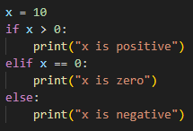
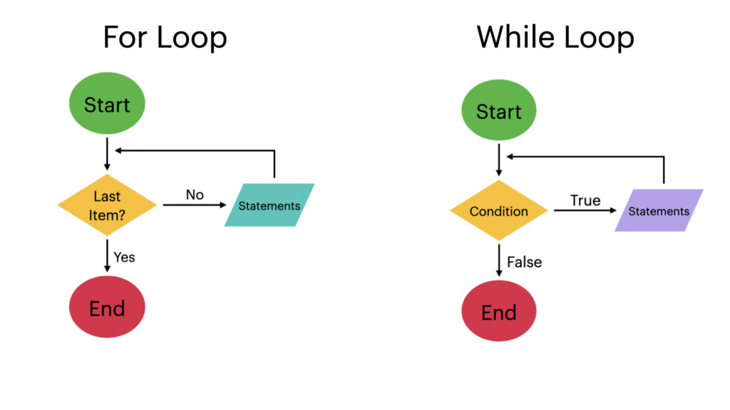


Python recall – control flow
Conditional Statements (if, elif, else):
Loops:

Slide 22
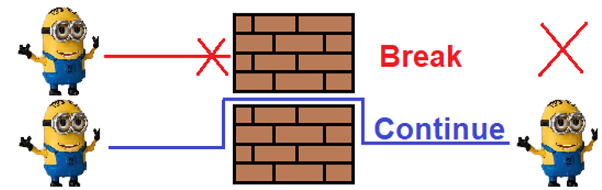
Python recall – control flow
Break and Continue Statements:
https://skilllx.com/python-flow-controls-break-continue-and-pass/

Slide 23
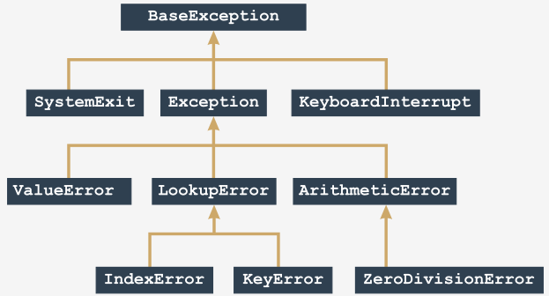
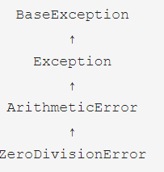
Python recall – control flow
Try-Except Blocks (Exception Handling):
https://edube.org/learn/programming-essentials-in-python-part-2-spanish/la-anatom-iacute-a-de-las-excepciones#:~:text=Python%203%20define%2063%20excepciones,encuentra%20en%20la%20parte%20superior.

Slide 24
Python recall – comprehensions
Concise ways to create lists, and dictionaries
List comprehension:
Dictionary comprehension:

Slide 25

Python recall – functional programming
Built-in functions:
len()
print()
max()
min()
sum()
Etc
User-defined functions:

Slide 26

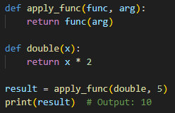
Python recall – functional programming
Anonymous functions (lambda functions):
Higher-order functions:

Slide 27
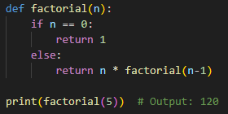
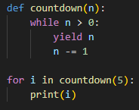
Python recall – functional programming
Recursive functions:
Generator functions:

Slide 28
Object-Oriented Programming (in Python)
There are two types of programming paradigms:
Procedure-oriented programming languages
Low reusability, many lines of code
Difficult to debug
Failure in any line results in program crash
Object-oriented programming languages (OOP)
Modularization
Created by Ole-Johan Dahl and Kristen Nygaard (Simula language, 1960s)
Examples: C++, Java, C#

Slide 29
Recall about OOP
Object: A composite data type used to represent a concept from the real world.
Attribute (of the object): A variable that accounts for a property of the object.
Method: Functions associated with the object.
Class: A generic template (common characteristics) that allows instantiation of objects.
Instance: An object that belongs to a class.
Creating an object from a class → Instantiating a class.

Slide 30
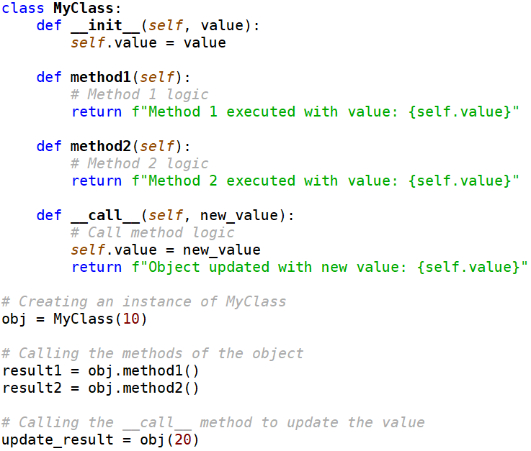
Recall about OOP

Slide 31
Inheritance and Class Hierarchies
A family of classes is known as a class hierarchy (Langtangen, H. P. (2016))
Parent class is a.k.a. base class or superclass
Child class is a.k.a. derived class or subclass
Child classes can:
inherit data and methods from parent classes
modify parent classes’ data and methods
add their own data and methods

Slide 32
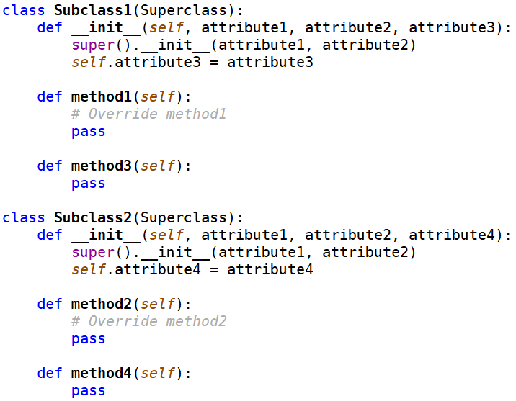
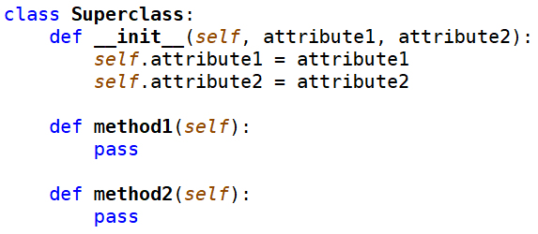
Inheritance and Class Hierarchies

Slide 33
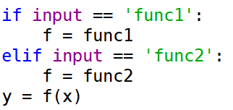
Dynamic binding (Polymorphism)
The ability of objects from different classes to respond to a method with the same name across various classes.
It can be achieved through inheritance.

